Slide 1
Information Systems and Data Modeling
IT1090

Slide 2
Contact Person
Lecturer In Charge:
Ms. Manori Gamage
Lecturers:
Prof. Mahesha Kapurubandara
Dr. Amitha Caldera
Ms. Sanjeevi Chandrasiri
Ms. Thamali Kelegama
Ms. Tharushi Rubasinghe
Enrolment Key: IT1090

Slide 3
Learning Outcomes
Learning Outcome | Description
LO1 | Explain the importance and impact of information systems in business organizations.
LO2 | Evaluate the information systems strategies to achieve organizational goals.
LO3 | Model data requirements using data models.
LO4 | Apply formal methods to refine the data model.
LO5 | Use SQL to store and modify the data in the database, and to write queries to satisfy real world application level problems.

Slide 4
Module Delivery
Lectures
2 × 1 hours of lectures per week
Tutorials
1 × 1 hour tutorial per week
Lab Sessions
2 × 1 hours of lab session per week

Slide 5
Assessment Criteria
Assessment components | Contribution to the final grade | Learning outcomes covered
Continuous assessments
Mid-term Examination | 20% | LO1-LO3
Assignment (Group) | 20% | LO1-LO5
Final Examinations
Final Examination (individual) | 60% | LO1-LO5
Total | 100%

Slide 6
Primary References
Laudon, K.C and Laudon, J.P., Management Information Systems: Managing the Digital Firm, 13th ed., Pearson Prentice Hall
Ramakrishnan, R. and Gehrke, J., Database Management Systems, 3rd ed., McGraw-Hill
SQL Server 2016 Documentation
Elmasri, R. and Navathe, S.B., Fundamentals of Database Systems, 5th ed., Addison-Wesley.
Silberschatz A., Korth H.F. and Sudarchan S., Database Systems Concepts, 3rd ed., McGrawHill , 1996
Connolly and Begg, Database Systems: A Practical Approach to design, Implementation and management, 3rd ed., Addison-Wesley

Slide 7
Information systems in business organizations
Lecture – 01

Slide 8
Learning Outcome
LO1: Explain the importance and impact of information systems in business organizations.

Slide 9
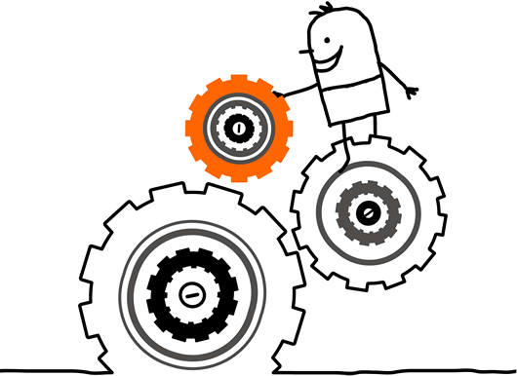
What is a System?

Slide 10
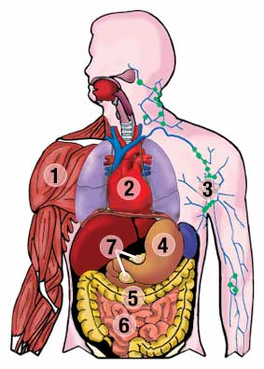
Example

Slide 11
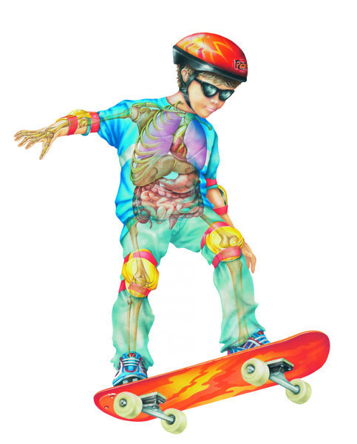
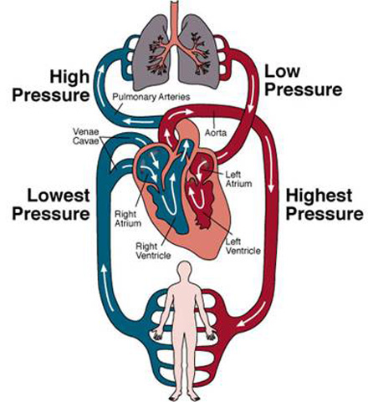
A System
An array of components that work together to achieve a goal or goals
components
work together
achieve a goal

Slide 12
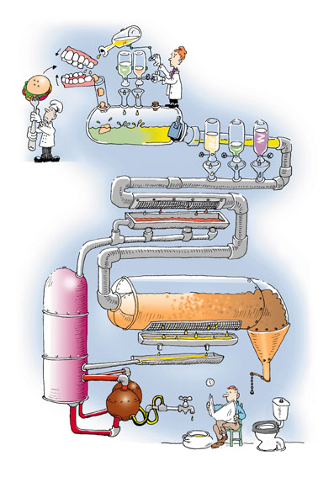

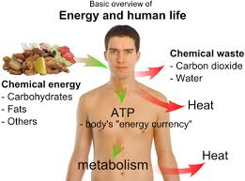
A System
Accepts input
Processes input
Produces output

Slide 13
A System
May have multiple goals
Eg: Goals of the human body
To Be Alive (Ultimate Goal)
To Work
To Survive
Contains Subsystems

Slide 14
What is a Subsystem..?

Slide 15
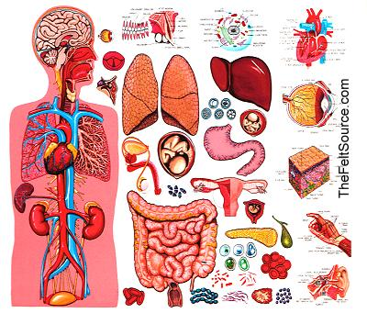

Slide 16
A Subsystem
Human Body
Respiratory System
Skeletal System
Muscular System
Digestive System
Nervous System
is a component of a system, it can also be considered a system in its own right.
have sub-goals that meet the main goal
transfer output to other subsystems

Slide 17
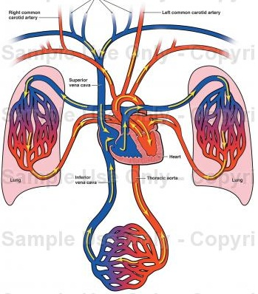
Subsystems Transfer Output to Other Subsystems

Slide 18

What is an Information System?

Slide 19
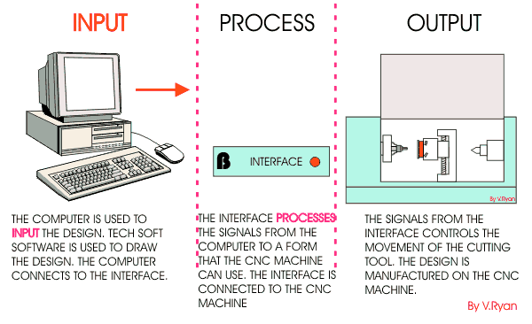
An Information System
Collection of components that work together to provide information to help in the operations and management of an organization.

Slide 20
Information Systems
An Information System collects, processes, stores, analyzes, and disseminates information for a specific purpose.
Information System is an arrangement of people, data, processes, information presentation, and IT that interact to support and improve day-to-day operations in an organization. (As well as support the problem solving and decision-making needs of various people)
An Information System is not necessarily be computerized.

Slide 21
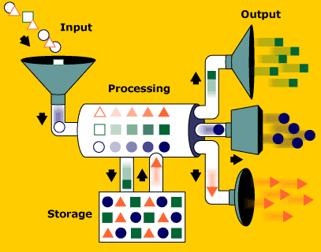
Components of an Information System

Slide 22
Components of an Information System
Hardware - Equipment such as computers
Software - Instructions for the equipment
Stored Data - Facts stored in the system
Personnel - People who operate the system
Procedures - for the user to follow

Slide 23
Examples of Information Systems
Library Information Systems
Banking systems
Inventory control systems
Billing systems
Hospital management systems
Hotel reservation systems
What are the information systems you know..?

Slide 24

E.g.: SLIIT Library Information System

Slide 25
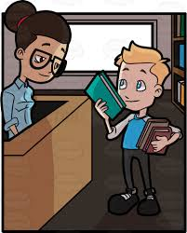
E.g.: SLIIT Library Information System
Let’s look at the library information system at SLIIT which provides the facility to borrow books for studies
Borrowing involves; students and staff registering to the system, selecting the desired material from the library and library assistant recoding it against the studentID

Slide 26

E.g.: SLIIT Library Information System
What information does this system provide?
Periodically the system reports on the books available, books overdue, membership
Calculates fines for overdue books
Check for valid membership

Slide 27
E.g.: SLIIT Library Information System
How does this information help?
This helps the Librarian to decide whether to understand the needs of the membership (add new books), track the borrowings and over dues, easy communication with membership

Slide 28
Functions of an Information System

Slide 29
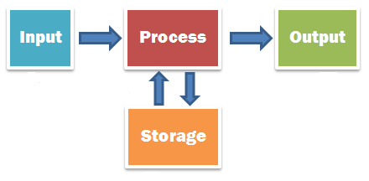
Functions of an Information System
An Information System accepts facts or data from outside the system, stores and processes the facts, and produces the results for use outside the system

Slide 30
Functions of an Information System
Input Function accepts the input data from outside the system.
Storage Function retains input data and retrieves stored data.
Processing Function calculates and in other ways manipulates the input and stored data.
Output Function produces results of processing for use outside the system.

Slide 31
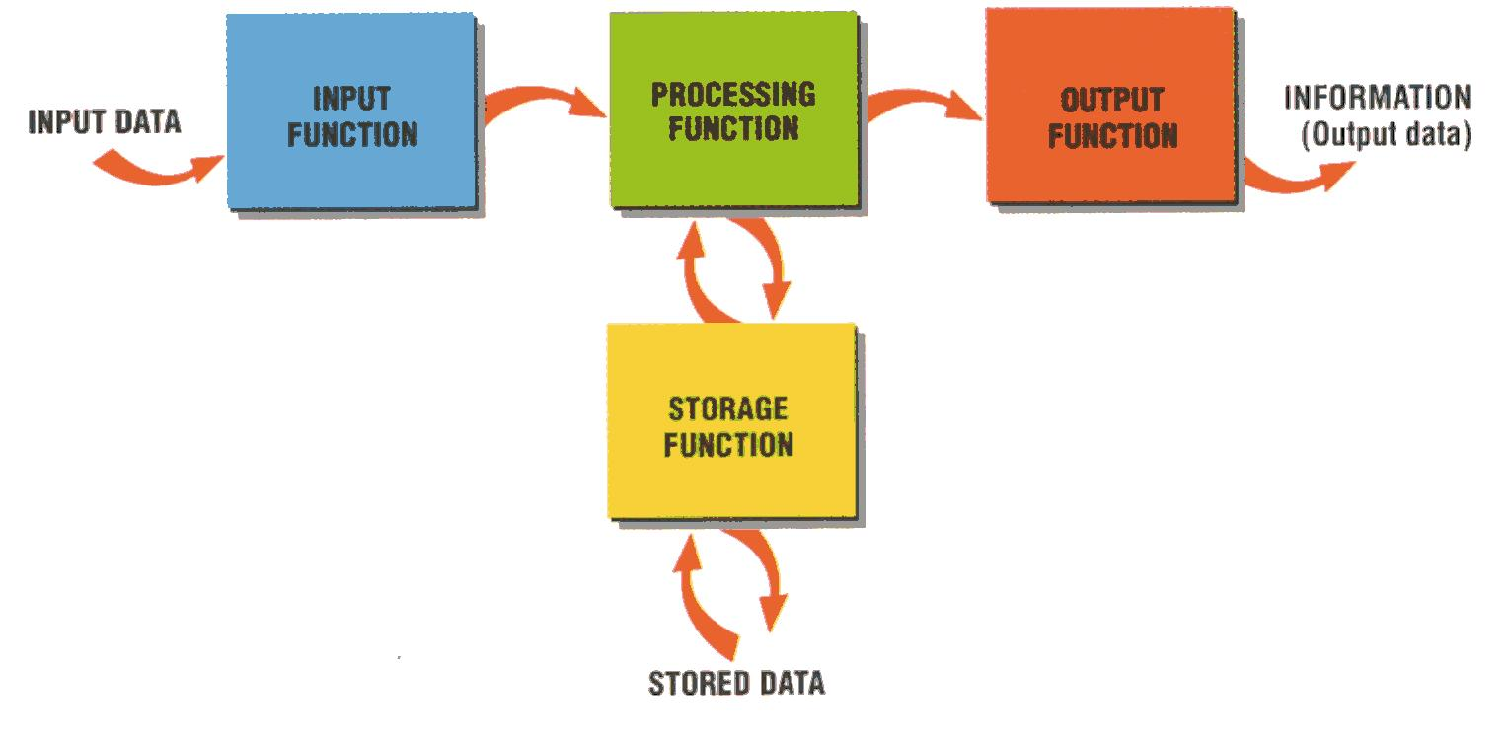
Functions of an Information System

Slide 32
Characteristics of Useful Information
Not all information is useful.
Useful information should be:
Relevant
Complete
Accurate
Current
Obtained economically (in business)

Slide 33

Information Systems Users

Slide 34

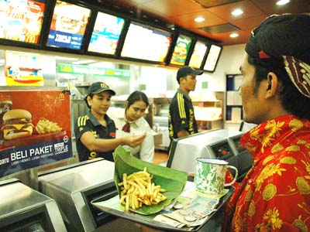
Information System Users
An information system user is a non-computer-oriented person who gains some benefit from using an information system in his or her personal or work life
Sometimes called as an end-user, to distinguish from computer professionals

Slide 35
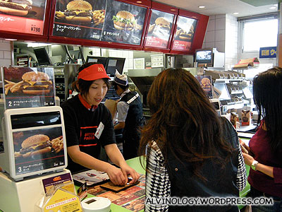
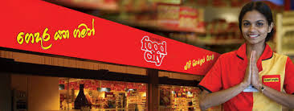
Information System Users
When you go to a fast-food restaurant and buy a hamburger, the counter person is the user of the retail food system
When you go to a retail goods store and buy some essential items, the cashier is the user of the point of sales system

Slide 36
Types of Information Systems Users
Direct Users - Users may use an information system directly by pressing keys on a computer keyboard or by operating a piece of equipment that sends input data to a computer
Eg.: A person using spreadsheet software to do financial projections
In-direct Users - A user may use an information system indirectly by having someone else enter the data and receive the output which is then given to the user
Eg.: A sales manager who receives periodic, printed sales reports

Slide 37
Any information system you know..??

Slide 38

Are Systems Unique..?
Some systems are unique to a particular industry;
Eg.: Health care industry
Patient-scheduling systems
Nursing allocation systems
Pharmaceutical systems

Slide 39
Are Systems general…?
Some systems are general enough for the use in a variety of industries;
Inventory
Payroll
Billing
Invoice Processing
Human Resource Management
Personal Productivity software

Slide 40

Categorization of Information Systems
So, we need a way to categorize Information Systems. There are many ways;
By number of people whose work is affected by the system
By organizational structure
By major functions
By support provided

Slide 41
Types of Information Systems
Personal Information Systems
Workgroup Information Systems
Organizational Information Systems
Inter-organizational Information systems
Global Information systems

Slide 42
Benefits of Information Systems
Better information
Improved service
Increased productivity
Competitive Advantage

Slide 43
How organizations use IS Today
Information systems transform business :
Increase in wireless technology use, Websites.
Increased business use of Web technologies.
Cloud computing, mobile digital platform allow more distributed work, decision-making, and collaboration.
Globalization opportunities :
Internet has drastically reduced costs of operating on global scale.
Presents both challenges and opportunities.

Slide 44
How organizations use IS Today
In the emerging, fully digital firm :
Significant business relationships are digitally enabled and mediated.
Core business processes are accomplished through digital networks.
Key corporate assets are managed digitally.
Digital firms offer greater flexibility in organization and management :
Time shifting, Space shifting

Slide 45
How organizations use IS Today
Growing interdependence between ability to use information technology and ability to implement corporate strategies and achieve corporate goals.

Slide 46
How organizations use IS Today
Business firms invest heavily in information systems to achieve six strategic business objectives:
Operational Excellence
New products, services, and business models
Customer and Supplier intimacy
Improved decision making
Competitive Advantage
Survival

Slide 47
Operational Excellence
Improvement of efficiency to attain higher profitability.
Information systems, technology an important tool in achieving greater efficiency and productivity.

Slide 48
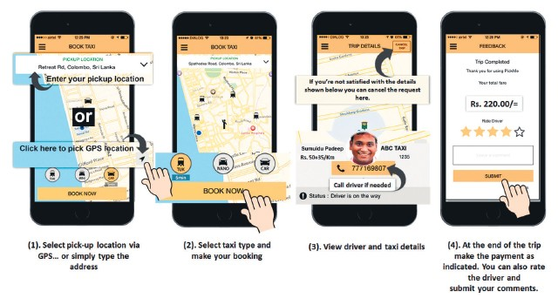
Operational Excellence cont.
E.g.:
Pick Me's vehicle reservation system connecting driver and traveler based on location-based services (GPS).

Slide 49
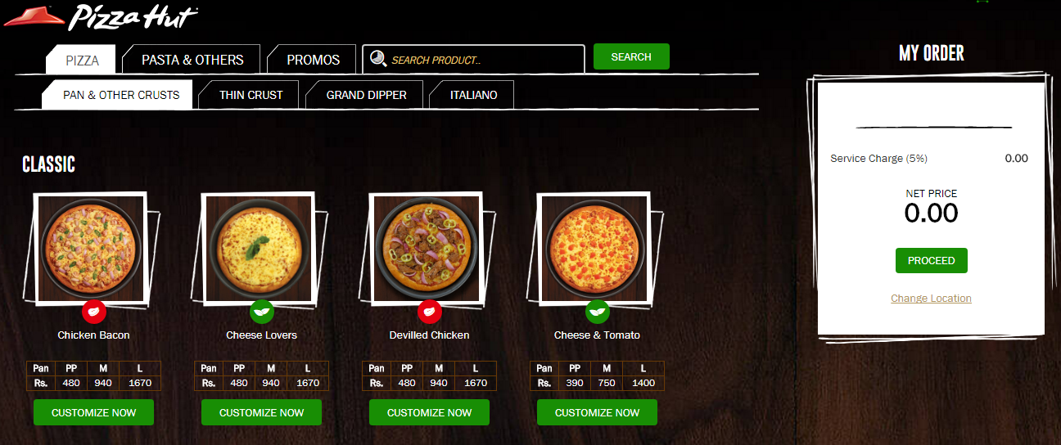
Operational Excellence cont.
E.g.:
Pizzahut’s ordering system providing an interactive menu for customers to place an order.

Slide 50
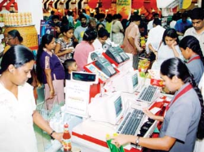
Operational Excellence cont.
E.g.:
Cargill’s Foodcity’s point of sales (POS) system allows the counter person to calculate payments.

Slide 51
New Products, Services, and Business Models
Business model: describes how company produces, delivers, and sells product or service to create wealth.
Information systems and technology a major enabling tool for new products, services, business models.

Slide 52
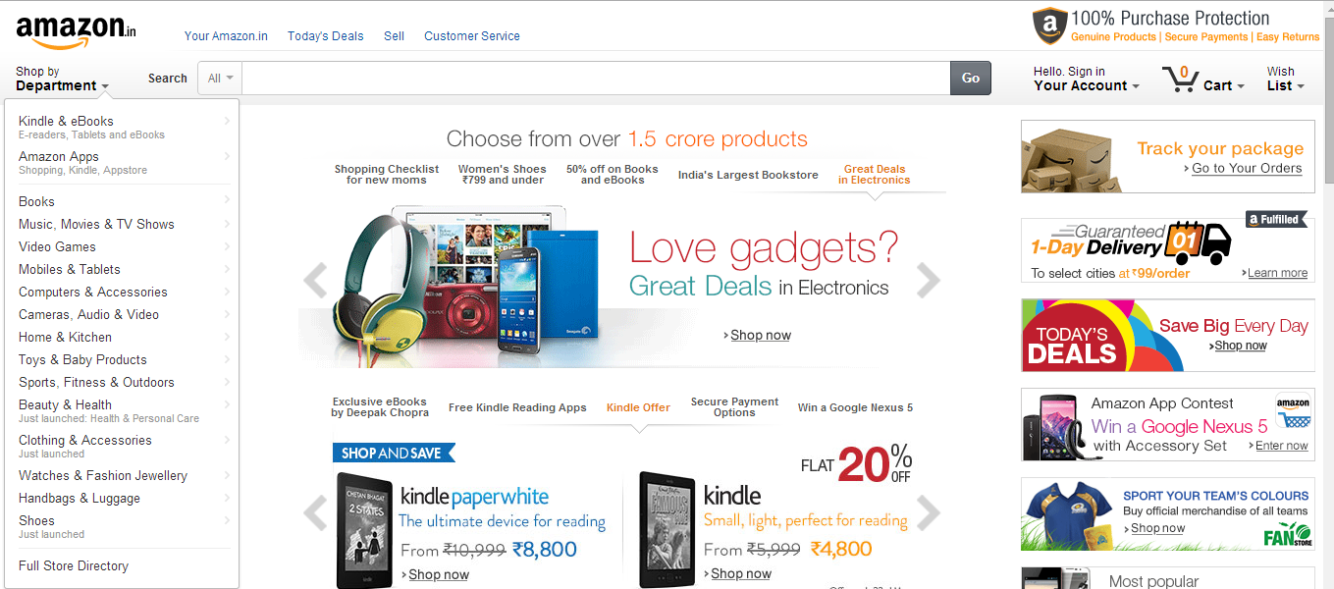
New Products, Services, and Business Models cont.
E.g.:
Online business model of Amazon.com

Slide 53
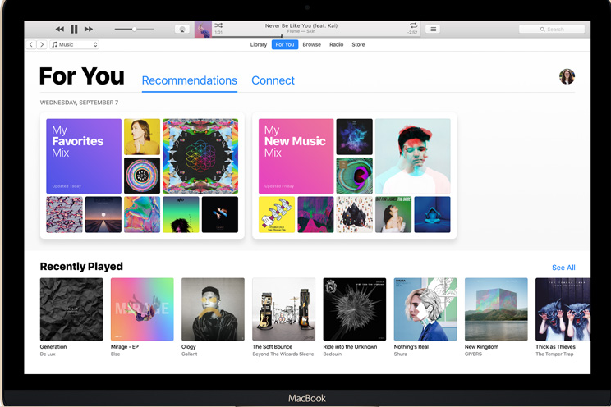
New Products, Services, and Business Models cont.
E.g.:
Apple’s iTunes

Slide 54
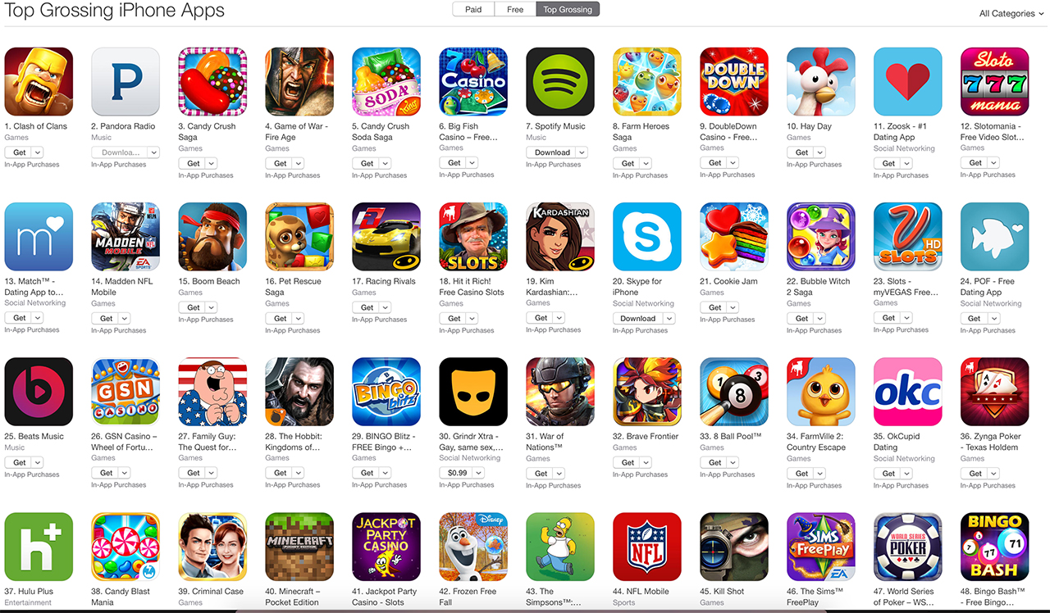
New Products, Services, and Business Models cont.
E.g.:
Google’s apps store for mobile applications

Slide 55
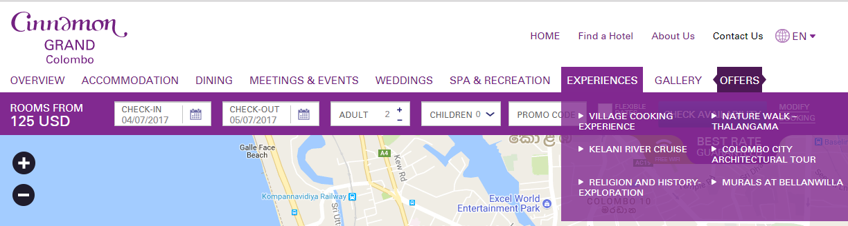
Customer and Supplier Intimacy
Serving customers well leads to customers returning, which raises revenues and profits
E.g.:
High-end hotels that use computers to track customer preferences and use to monitor and customize environment

Slide 56
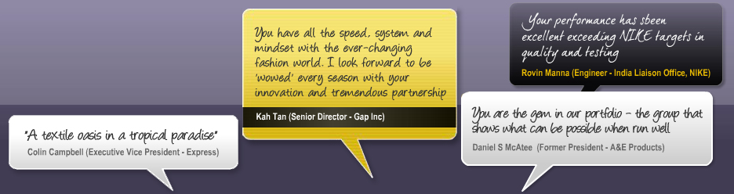
Customer and Supplier Intimacy
Intimacy with suppliers allows them to provide vital inputs, which lowers costs
E.g.:
Brandix’s information system which links supplier to contract manufacturer

Slide 57
Improved Decision Making
Without accurate information:
Managers must use forecasts, best guesses, luck.
Leads to:
Overproduction, underproduction of goods and services
Misallocation of resources
Poor response times
Poor outcomes raise costs, lose customers.

Slide 58
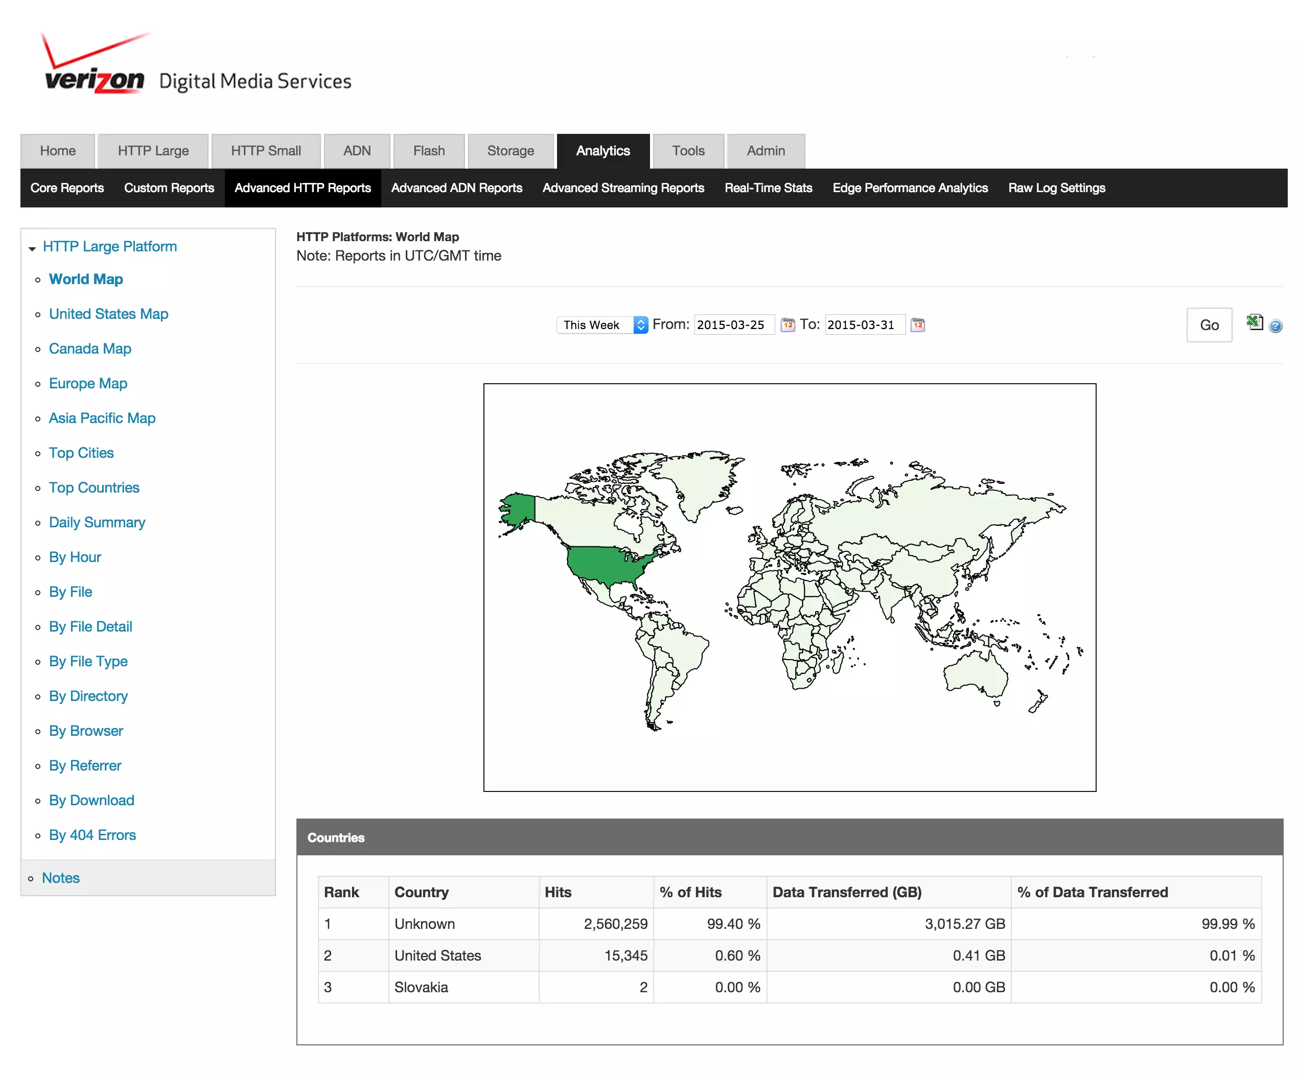
Improved Decision-Making cont.
E.g.:
Verizon’s Web-based digital dashboard to provide managers with real-time data on customer complaints, network performance, line outages.

Slide 59
Competitive Advantage
Delivering better performance
Charging less for superior products
Responding to customers and suppliers in real time

Slide 60
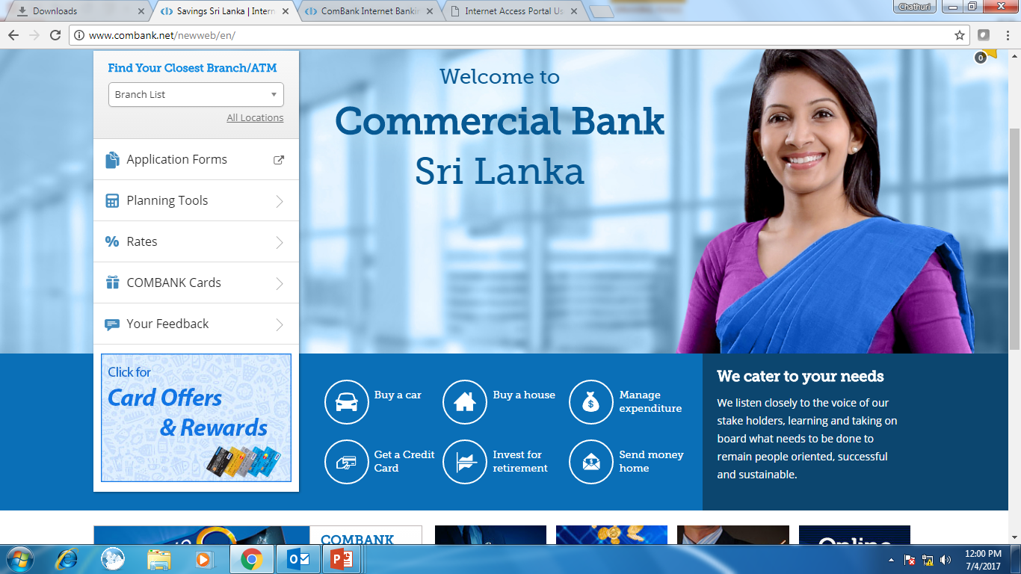
Competitive Advantage cont.
E.g.:
Online banking for customers.

Slide 61
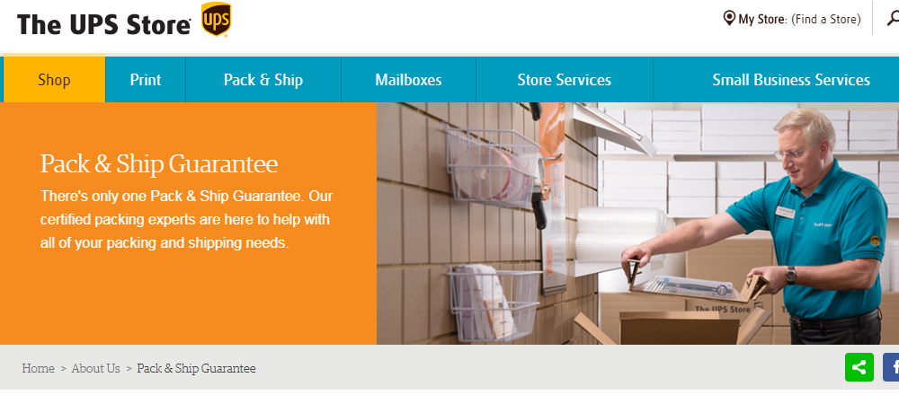
Competitive Advantage cont.
E.g.:
UPS online product tracking system for shipping and delivery.

Slide 62
Survival
Some industries are heavily dependent on technology.
Hence all businesses in the industry need to maintain the basic technologies used in the industry.

Slide 63
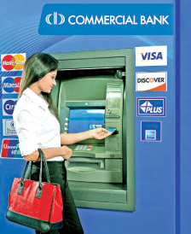
Survival cont.
E.g.:
ATM systems for banks.

Slide 64

End of Lecture - 01
Questions..?

Slide 65

Reference
K. C. Laudon and J.P. Laudon, “Management Information Systems: Managing the digital Firm”, Chapter 1, INFORMATION SYSTEMS IN BUSINESS TODAY, 13th Ed, 2014

Slide 66
Next Lecture
Gaining competitive advantage using information systems

